Slide 1


AI TECH WEBSITE
Created By:
Harsh Gupta
Ritvik Bhargava

Slide 2
Contents
About Project
Language’s Used
Introduction
Preview
Resources

Slide 3

ABOUT PROJECT
Basically, this website is created for learning purpose (to learn javascript and it’s features), and by this we can find latest blogs related to AI and get latest updates here.

Slide 4
Language’s Used
JavaScript
ReactJS
CSS
Node.js

Slide 5

01
Introduction To AI
03
Introduction To JavaScript
02
Introduction To React
04
Introduction To NodeJS

Slide 6
INTRODUCTION TO AI
Artificial intelligence (AI) is the ability of a computer or a robot controlled by a computer to do tasks that are usually done by humans because they require human intelligence and discernment.

Slide 7
INTRODUCTION TO JavaScript
JavaScript is used to develop interactive web applications. JavaScript can power featured like interactive images, carousels, and forms

Slide 8
INTRODUCTION TO NodeJS
Node.js is a platform built on Chrome's JavaScript runtime for easily building fast and scalable network applications.

Slide 9
INTRODUCTION TO React
React (also known as React. js or ReactJS) is a free and open-source front-end JavaScript library for building user interfaces based on UI components

Slide 10
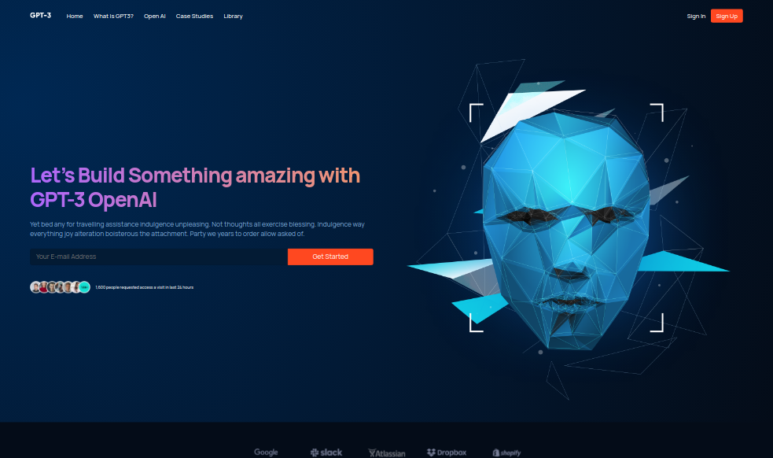
DESKTOP PREVIEW

Slide 11
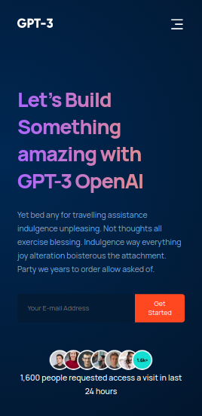
MOBILE PREVIEW

Slide 12
RESOURCES OR REFERENCES
https://www.figma.com/file/lz9lLpFHMxHm2odnwM3R0z/gpt3?node-id=0%3A15
https://www.youtube.com/watch?v=LMagNcngvcU&t=9377s
https://angrytools.com/gradient/
https://animista.net/play/basic/scale-up

Slide 13
THANKS!

